Slide 1

Analysis on MRT3 Ridership 2017
DATASCI FINAL PROJECT

Slide 2
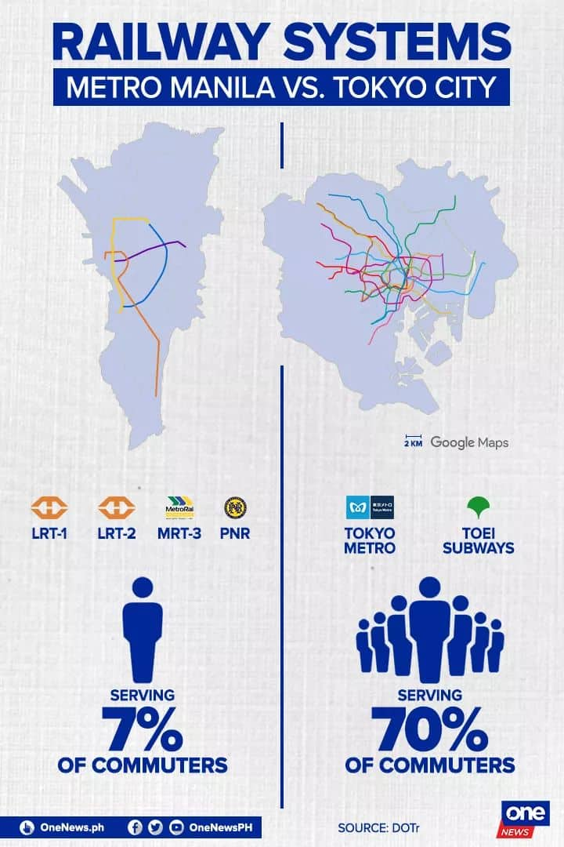
Project Overview
One of the most prominent issues that residents face in Metro Manila is the horrendous experience in public transportation.
Although debatably the fastest way to get to places, it is one of the most uncomfortable modes of transportation due to the long queues, overloaded trains and frequent breakdowns.
“It is estimated that millions of man-hours are lost each day as commuters wait for their turn for an hour or more before riding the three rail systems, which are supposed to make travel faster and easier for passengers.” (dela Cruz, 2015)

Slide 3
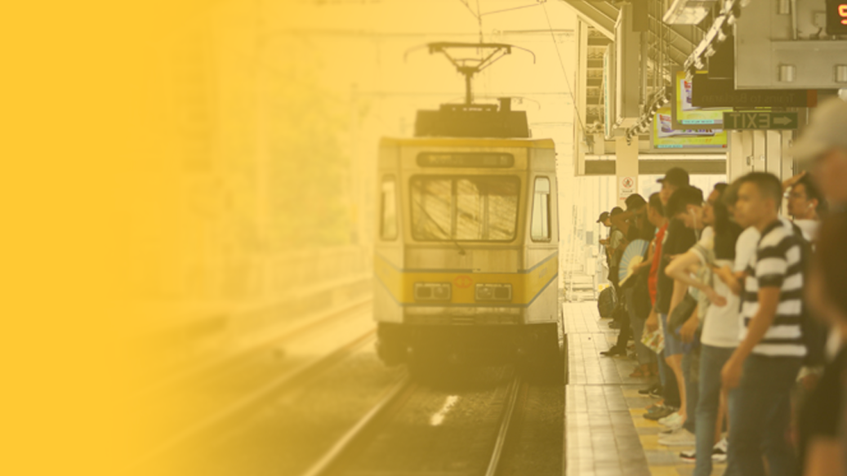
Project Motivation
NOT ENOUGH TRAINS
The low supply is not enough to satisfy the current increasing demand.
The best solutions would require large amounts of budget and resources.
PROBLEM QUESTION
Given a set of data, how can we determine optimal train schedules and/or suggest improvements to the MRT system?

Slide 4



General Objective
The general objective is to analyze trends and patterns of commuter behaviour and Metro Rail Transit Line 3 traffic activity and ridership on a monthly, weekly, daily, and hourly basis.
Specific objectives include:
Determine the peak hours and days of traffic activity and ridership in the MRT
Determinine the volume and congestion of passengers in specific stations in a certain time
Determine the optimal schedule (time and starting station) of skip trains and the most optimal interval times

Slide 5
Data Cleaning
The data wrangling processes are the following:
Manual editing of data from a csv dataset
Sorting of data: includes months, stations, etc.
Data type manipulation: it includes converting the month and day to a datetime format.
Data merging: combining two dataframes (station values and station points)
Inserting new columns: includes Summing and Averaging
Geospace Initialization: cleaning the station points and PH map

Slide 6
Used Dataset
Daily number of passengers who have entered and exited per station on average, percentage and total in Metro Rail Transit Line 3 in 2017.
https://drive.google.com/file/d/1Ly-YzLlS2BjjczC4nduDqGL6CHvRKhNL/view

Slide 7

Exploratory Visuals
Data visualization will mostly deal with time series analysis on station entries. Station exits will NOT be included in the analysis. Data visualization will include:
Geospatial
Heatmaps
Time series line graphs

Slide 8
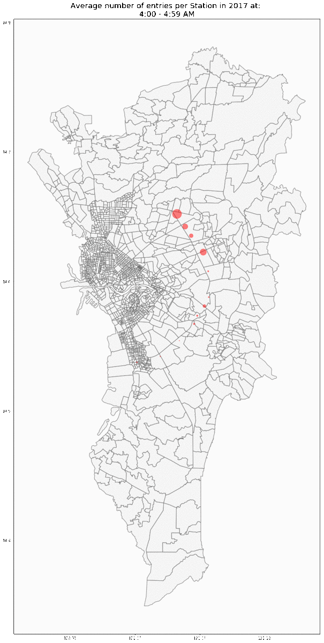
Average commuter traffic activity on different stations in a day in 2017
Observations:
There is always a large traffic activity at the end stations (North ave and Taft), and mid stations.

Slide 9
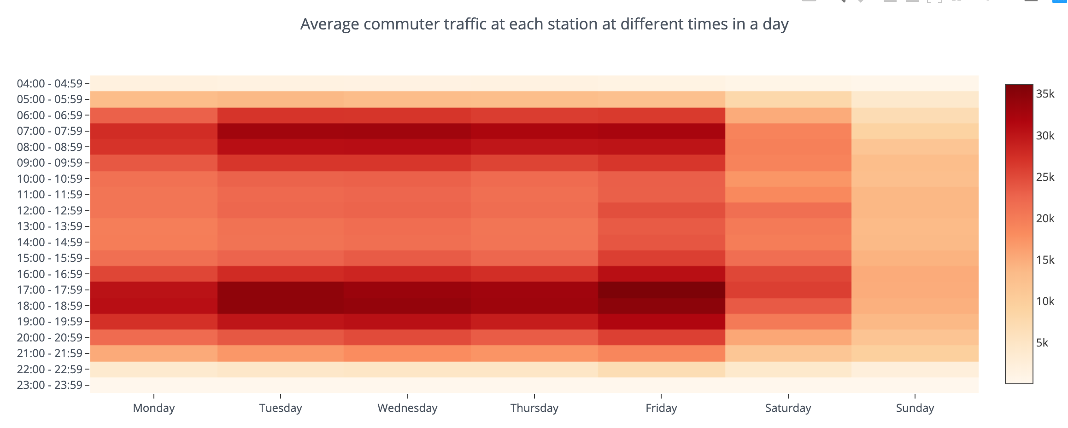
Observations:
Most congested hours are start and end of working hours.
Peak day is friday, least busiest is sunday

Slide 10
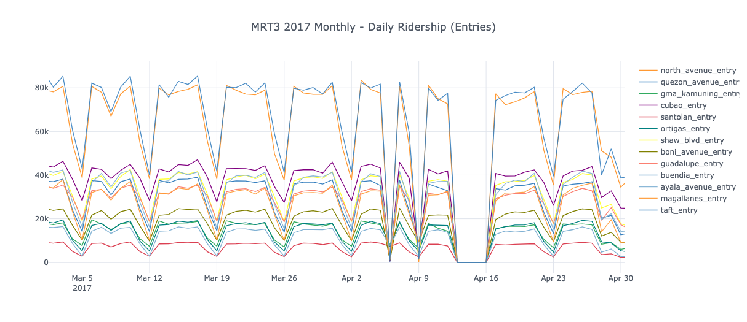
Observations:
Traffic activity is most congested at the end stations
The least commuter traffic activity is found at Santolan station and GMA Kamuning station

Slide 11
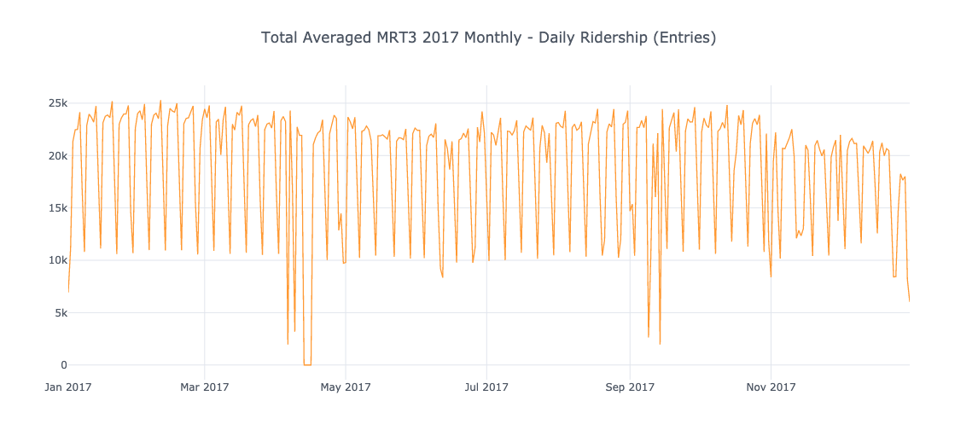
Observations:
There are less commuters during Summer (Apr-Jun) and Ber-months (Nov-Dec)versus the other months
Note: There was no MRT3 activity on Apr 13 - Apr 16, 2017

Slide 12


Test Hypotheses
The entry population at the End Stations (Taft and North) are significantly larger than that of the average entries of all stations
The station congestion on Fridays is significantly higher than on the other days of the week
Stations are busiest at the the start and end of the commuters’ working hours versus other times in the day.
There are less commuter activity during Summer (Apr-Jun) and Ber-months (Nov-Dec) versus the other months

Slide 13
Statistical Tests
Most of the hypothesis underwent Z-Testing used to test a hypothesis on a specific value of the population proportion.
End station entries versus Overall station entries
Station congestion at peak hours versus Average station congestion activity within a day
Station congestion on Fridays versus Average Station congestion of a week

Slide 14

Conclusion and Recommendations
Commuter traffic is most congested at end stations
7AM-8AM and 5PM-6PM are the busiest hours
Friday is the worst day to ride the MRT3
Skip trains can be reinforced during peak hours to prioritize the end stations and opt to skip Santolan and GMA Kamuning stations due to their low commuter traffic activity.

Slide 15
Limitations
1
The dataset used is from 2017. The results might not reflect the current trends and may not be accurate for 2019.
Geospatial Dataset did not have the Ayala station
The hours provided were in time-range (XX:00 - XX:59) format. A more precise time series analysis could not be possible.
2
3

Slide 16
Hamoy Ken

